Slide 1
Postcolonial poetry:
The mirage of national identity and the possible otherness
Mauricio Jiménez
Mario Naranjo

Slide 2
Why poetry?
We feel inspired by writers and thinkers such like Aimé Cesaire, José Emilio Pacheco, Mahmoud Darwish, G. Ch. Spivak, Emmanuel Levinas, et.al.
We think poetry as an empathic and aestethic way to connect with otherness
We believe that poetry is an excellent vehicle to discuss, think and feel the complexities of postcolonial condition and the sufferings inside this condition
We think freedom of language opens the opportunity to name the world from a different point of view.
We are convinced that academic discourse is limited by the standards of hegemonical science and thought

Slide 3

What do we pursuit?
To establish bridges between two different discoursive fields: literature and theory
In order to transgress the boundaries of neutrality and stoicism of academic standards
To appeal to human feelings and emotions looking to connect with other sensibilities

Slide 4
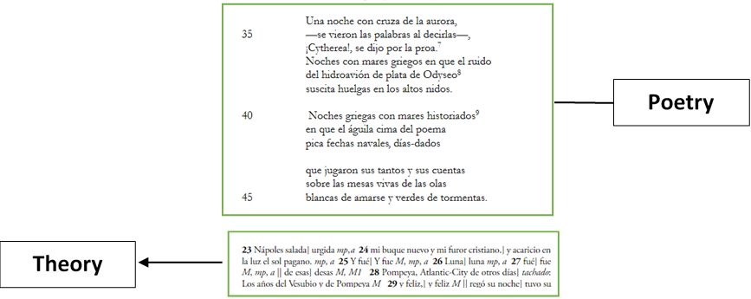
How we will do it?
A poem based on decolonial theory with bibliography, references and foot/final notes
Through this format we can use different languages and refer to historical events and distant geographies

Slide 5
Topics to explore…
National state as a “failed project of emancipation”
A critic to national identities
The migrant condition
The cuestión of indigenous people, natives, original settlers…
Selfreflection about the use of language and colonial discourses
Selfreflection of the poem about itself
Another possibilities: the use of the past and narratives, intelectuals and elites, colonial mentalities, capitalism and structural violence,

Slide 6
Thank you for your attention and comments. Do you have another ideas?

